Slide 1
Working with Workgroups and Domains
Lesson 9

Slide 2
Objectives
Understand users and groups
Create and manage local users and groups
Understand the difference between workgroups and domains
Configure user account control (UAC)
Notes:
Outline the material you are going to cover in this lesson. Do not go into detail as each of these points will be expanded on in the lesson. You may also want to mention the Technology Skills that are being covered for the Certification exam also.

Slide 3
Working with Users and Groups
Users
Group – A collection of users
Authentication
Authorization
Permissions
User rights
Notes:
Introduce Users and Groups and basically what they are used for in a Windows network. These concepts will be expanded on in the different networking environments in the next slides.

Slide 4
Understanding Local and Domain Users
Homegroup
Workgroup
Domain
Notes:
It is important to understand the different network

Slide 5
Introducing the Homegroup
Simplified networking
Allows users on a home network to share the contents of their libraries without creating user accounts and permissions
Notes:
Refer to Lesson 6 for information about HOW to create a HomeGroup and for additional information.

Slide 6
Introducing the Workgroup
Peer-to-peer network
Each computer can function as both a server and a client
Each computer has its own set of users and groups to control access to its own resources
Small networks, little security required
Notes:
Discuss the Workgroup and how a user logs on to each computer on the network. Discuss pass-through authentication and why workgroups are only intended for small, informal networks.

Slide 7
Introducing the Domain
Collection of computers that utilize a central directory service for authentication and authorization
At least one Domain Controller is required
Domain Controller
Notes:
Discuss the properties of a domain and how users logon and gain access to resources. It may be useful to use information from Lesson 6 about how users are authenticated and authorized.

Slide 8
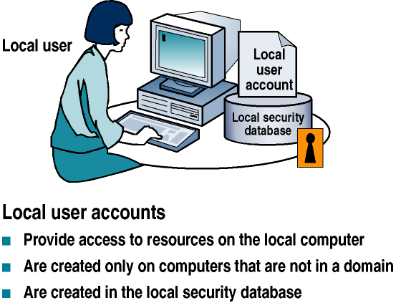
Local User Accounts
Notes:
Explain the properties of a Local User Account. See the properties sheet on the next slide.

Slide 9
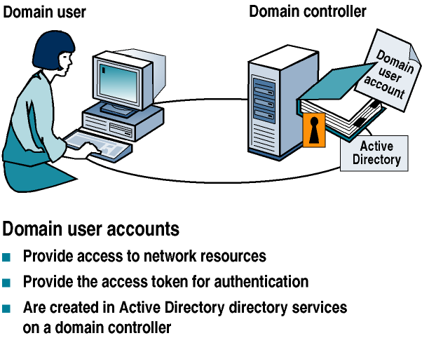
Domain User Accounts
Notes:
Explain how a user account works in a Domain Environment. Refer to the Domain User Account properties sheet on the next slide.

Slide 10
Introducing Built-In Local Users
Administrator
New User Account
Guest
Notes:
Explain the 3 built-in local user accounts and their purpose.

Slide 11
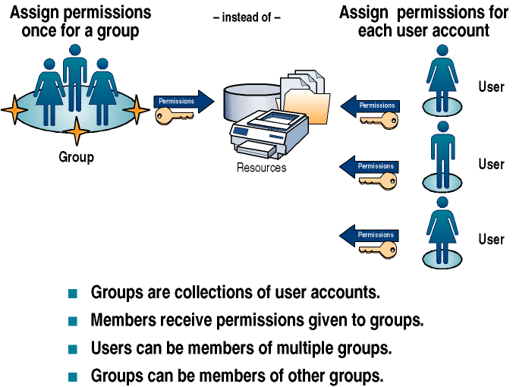
Understanding Local and Domain Groups
Notes:
Use the diagram to explain what a group is and what it is used for.

Slide 12
Using Local Groups
You can only use local groups on the computer where you create them.
Only local users from the same computer can be members of local groups.
When the computer is a member of an AD DS domain, local groups can have domain users and domain global groups as members.
Local groups cannot have other local groups as members. However, they can have domain groups as members.
You can only assign permissions to local groups when you are controlling access to resources on the local computer.
You cannot create local groups on a Windows server computer that is functioning as a domain controller.
Notes:
Describe the restrictions placed on Local Groups.

Slide 13
Introducing Built-In Local Groups
Administrators
Backup operators
Power users
Guests
Remote desktop users
Users
Notes:
These are some of the basic Built-in Local groups on a Windows 7 computer. The full list is in the book and additional groups are added if different services are running on the computer. Explain these basic groups, what users are in them by default, and what they are used for.

Slide 14
Introducing Special Identities
Everyone
Interactive
Network
Anonymous logon
Authenticated users
Creator owner
Dialup
Notes:
A special identity is essentially a placeholder for a collection of users with a similar characteristic. For example, the Authenticated Users special identity represents all of the users that are logged on to the computer at a given instant. You can assign rights and permissions to a special identity just as you would to a group.
Some of the special identities are on the slide. Explain each one and refer to the full list in the book.

Slide 15
Creating and Managing Local Users and Groups
User accounts – In the Control Panel
Local users and groups – MMC snap-in
Notes:
Explain when each of these tools is used to create and manage users and groups. More detail will be provided in the next slides.

Slide 16
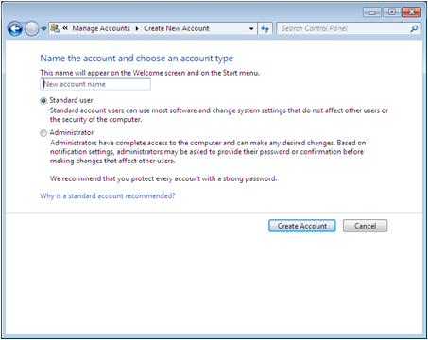
Using the User Accounts Control Panel
Intended for users with less experience
Simplified interface
Limited access
Cannot create or manage groups
Notes:
Explain in more detail who would use this tool and what the advantages and limitations are.

Slide 17
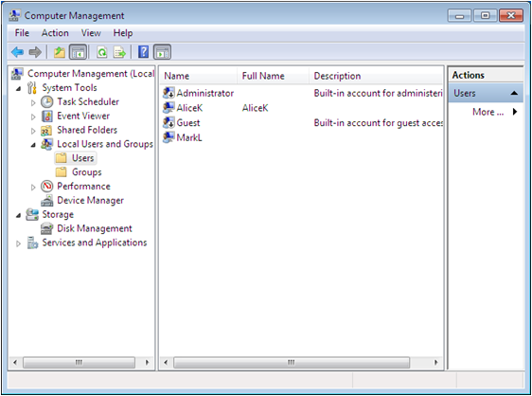
Using the Local Users and Groups Snap-In
Gives more access to user account properties
Allows you to create and manage groups
Notes:
Explain in more detail who would use this tool and what can be done with this tool that cannot be done with the User Accounts Control Panel option.

Slide 18
Understanding User Profiles
Local user profile – that Windows 7 automatically creates when a user logs on for the first time
Roaming user profile – a copy of the local user profile stored on a shared drive making it accessible from anywhere on the network
Mandatory user profile – a roaming profile that users cannot change (read only). Used by Administrators to enforce particular desktop settings for individuals or groups of users
Notes:
Describe the 3 types of profiles.

Slide 19
Introducing User Account Control (UAC)
Because many users log on to the system using Administrative Accounts (leaving the system vulnerable to malware attacks) Microsoft implemented UAC.
Under UAC, administrators are issued two access tokens—1 standard token and 1 administrative token.
Best Practice is to logon as a standard user unless performing administrative tasks.
Notes:
Discuss how users and technical specialists login as administrative users to make it convenient when administrative tasks need to be done. Discuss the problems with doing this and then introduce UAC.

Slide 20
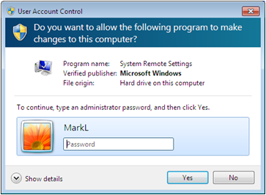
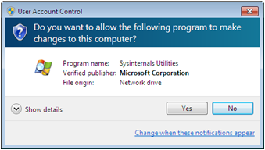
Performing Administrative Tasks
Standard User Account
Administrative Account
System displays a credential prompt where administrative account information must be entered
Switches from standard user token to administrative token
Generates an elevation prompt
Notes:
Describe the difference between performing an Administrative Task with a Standard Account vs with an Administrative Account

Slide 21
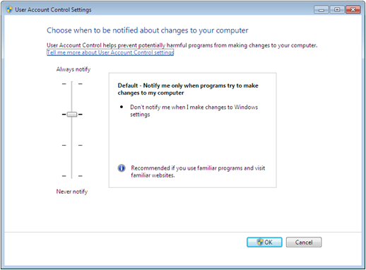
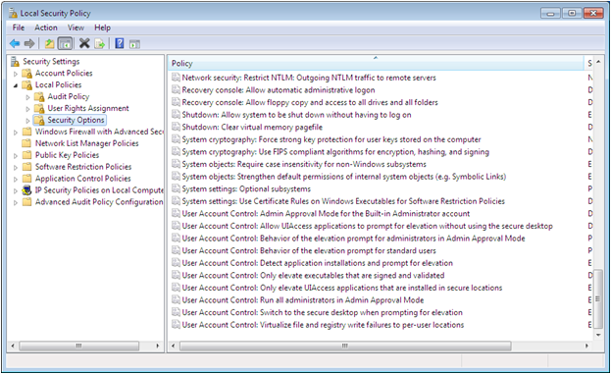
Configuring User Account Control
Can be configured or disabled
Notes:
Explain the settings that can be changed in User Account Control Settings and the Local Security Policy. Note that is can also be completely disabled.

Slide 22
Skills Summary
The user account is the fundamental unit of identity in the Windows operating systems.
A group is a collection of users.
A workgroup is a collection of computers that are all peers, and can act as a client or server.
A domain is a collection of computers that all utilize a central directory service for authentication and authorization.
Built-in local groups are equipped with the permissions and rights needed to perform certain tasks.
Notes:
Review the Skill Summary to wrap up your lesson.

Slide 23
Skills Summary (cont.)
Windows 7 provides two separate interfaces for creating and managing local user accounts: the User Accounts control panel and the Local Users and Group snap-in.
The three profile types are local, roaming, and mandatory.
User Account Control (UAC) allows an administrative user to perform regular user tasks as a standard user, and switches to an administrative token only to perform administrative tasks.

